Slide 1
Natural Autoencoding
Irun Cohen¹ and Assaf Marron²
¹ Dept. of Immunology and Regenerative Biology
² Dept. of Computer Science and Applied Mathematics

Slide 2
“…and Justice for All”
Moshe at our undergraduate graduation ceremony
M.Y Vardi: “How to be an Ethical Computer Scientist”

Slide 3
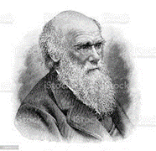
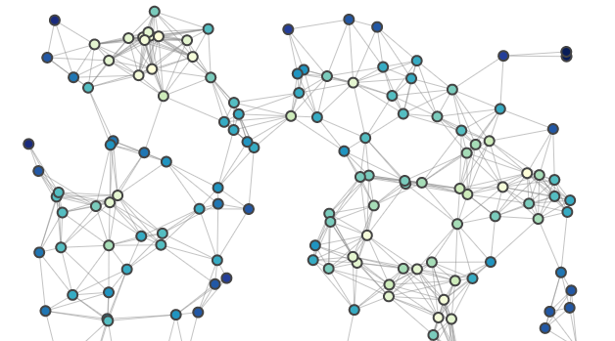
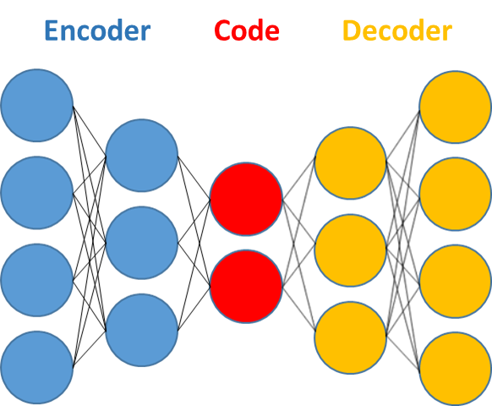
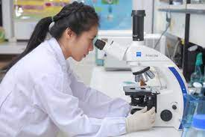
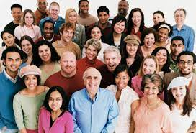
A Brief Summary
In contrast to Darwinian Survival of FITTEST individuals, our mechanism of Survival of the FITTED [1] argues that successful survival emerges from participation in collective interaction networks
Nature’s interactions converge into patterns, resulting in autoencoding into interaction codes [2]
Evolution is the narrative of re-autoencoding of interaction codes as triggered by innovations (environmental, genetic, behavior)
Natural autoencoding mechanism differs from typical artificial autoencoding: it is recursive, unending, with no optimization process
Significant implications to science, human social behavior, and humans interaction with the biosphere
[1] Cohen & Marron, F1000Research 2020; [2] Cohen & Marron, arXiv, 2022
. . .

Slide 4
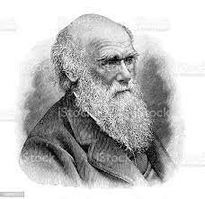
Darwinian Principles of Evolution
Natural Selection and Survival of the Fittest (with subsequent accommodation of genetics):
Domination by individual variants having reproductive advantage Competitive struggle is central

Slide 5
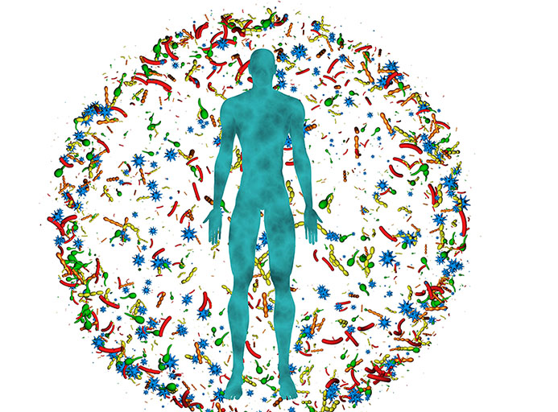
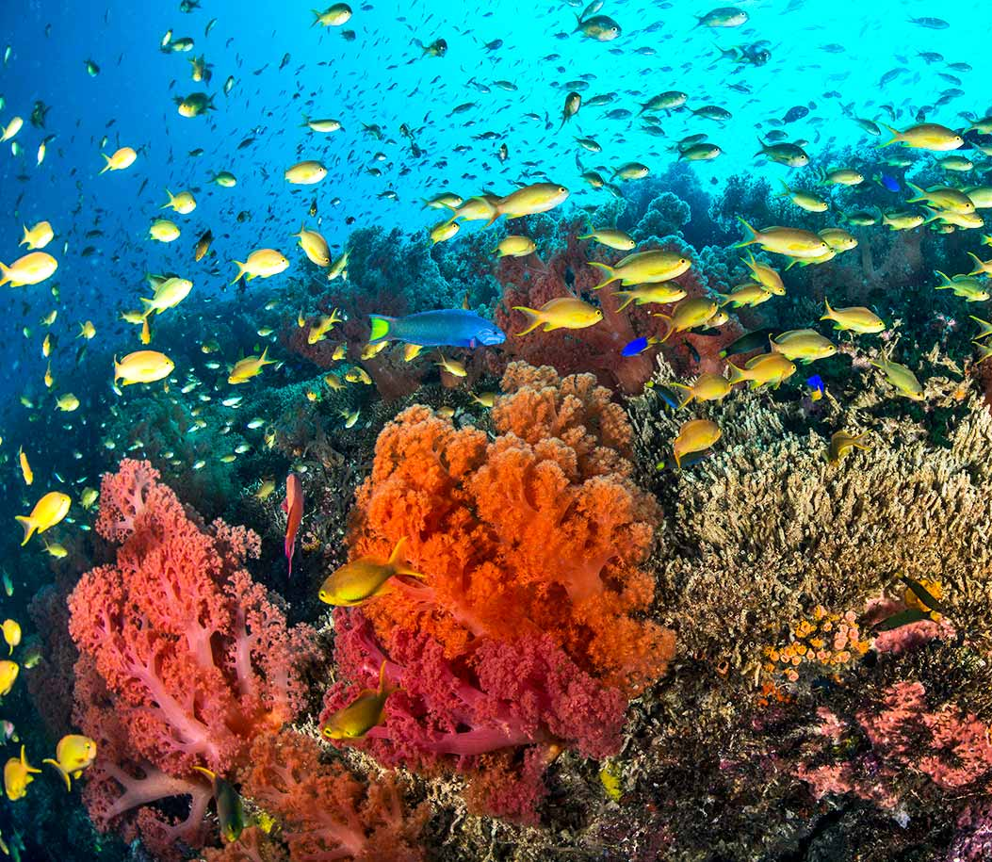
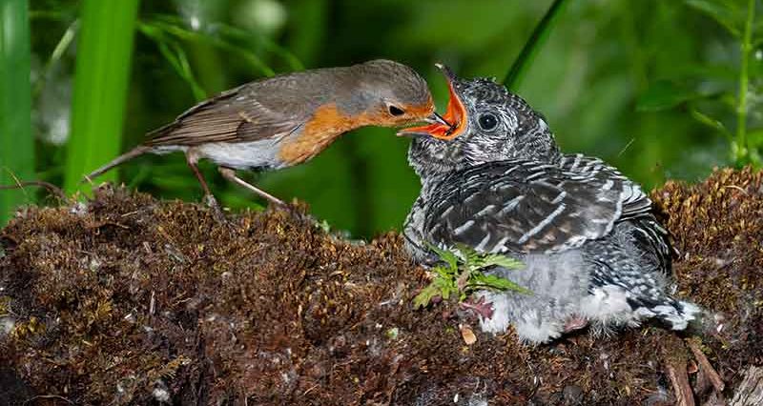
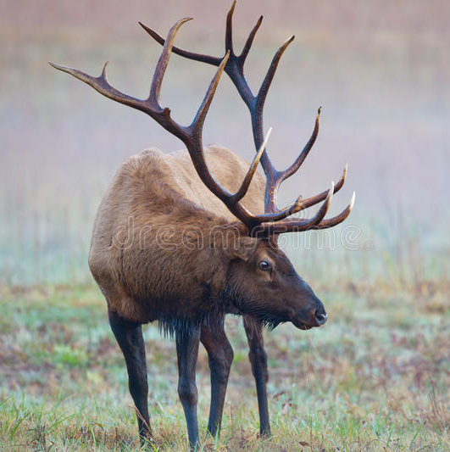
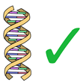
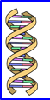
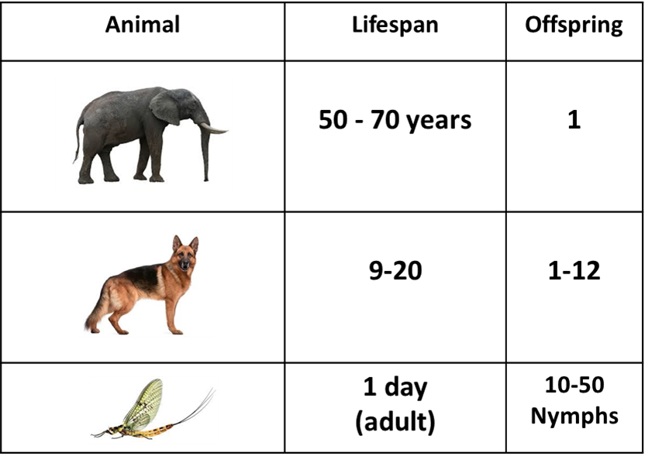
Shortcomings of Natural Selection Theory
Does not predict and doesn’t readily account for:
Network organization of the biosphere: Microbiomes, Coral reef diversity Fungi-and-trees, …
Altruism: Assistance & Sacrifice
Inefficiencies: huge antlers, elaborate bird bowers, …
Sexual reproduction: Reshuffling of “fittest” genes
Species’ encoded lifespans & birth rates
+

Slide 6
Survival of the Fitted
First conceived by Irun (Yaron) Cohen
The very act of interaction induces stability
Interaction networks retard entropic destruction
Interactions converge into patterns/codes
Evolution is the narrative of change in species interaction codes. Competition & reproductive differences are secondary
Interaction Codes:

Slide 7
Species Interaction Code
“The fundamental, core interactions of the species with its external and internal environments”

Slide 8
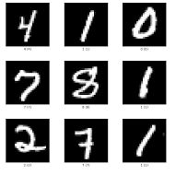
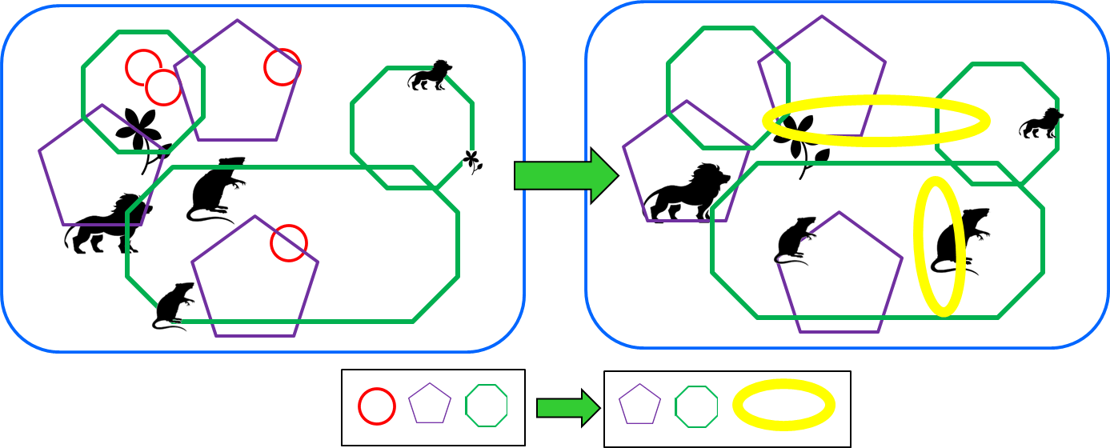
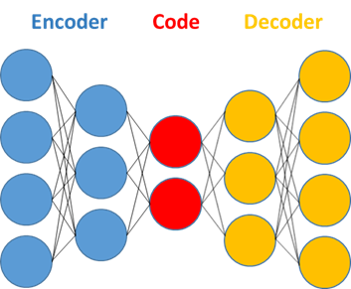
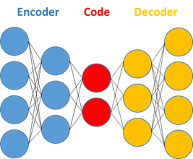
Species Interaction Codes Evolve by Natural Autoencoding
Artificial Autoencoding:
A ML/AI/NN technique for extracting key features of data
Iteratively encodes and reconstructs inputs
Example: Encode digits as lines, arcs, ellipses parameterized by position, size, etc.
Used for noise reduction, anomaly detection, classification
Natural Autoencoding: The biosphere’s reactions to innovations (external & internal) can reshape or extinguish species interaction codes
Notes:
.

Slide 9
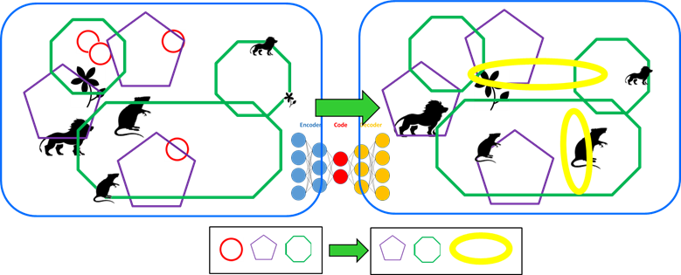
Unique Characteristics of Natural Autoencoding
No “optimization” process:
No loss function to check fidelity of input reconstruction
“Selection” / sustainment is only in retrospect: “What Works, Works!”
Continues indefinitely
Recursion / reflection:
The autoencoder machinery is part of its own input
Many codes, multiple scales
More . . .
In D. Harel’s group we are now developing agent-based and neural net models of Natural Autoencoding (with G. Frankel, S. Szekely)
Time

Slide 10
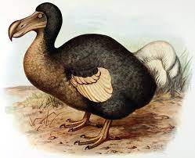
Significance of Survival of the Fitted
To science:
Sheds new light on our understanding of nature and our conduct of research.
To human society:
Classical Darwinian thinking has negatively affected human politics (tyranny, colonialism), economic theory (brutal capitalism), social organization (racism), and more.
Understanding the sustainability and resilience of diverse networks can help bring about necessary changes in human society and in the relationship of humans and the environment.

Slide 11
Questions
Thank You!

